Slide 1
The Robbe Atlantis
In Drydock
R/C Model Project for Client

Slide 2
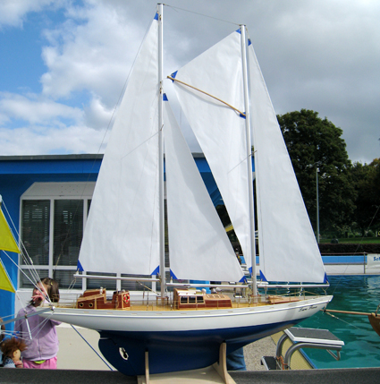
The Robbe Atlantis

Slide 3
The Robbe Atlantis
Unfinished model for a client in memory of her husband
Intended as a Radio Controlled sailable model
  6 Servos
    Sails (2)
    Anchor winch (1)
    Motor (1)
    Rudder (1)
    Lights
    Typical German ingenuity in terms of controls
    Nightmare of pulleys, cables and wires below deck
Luckly client wishes it to be fully rigged but static
Market price of full model kit circa 1990’s >$1000!

Slide 4
The Robbe Atlantis
Hull molded ABS Plastic that comes in 2 pieces
Model (nearly 6 feet tall in a stand)
    55” Long
    13.5” Beam
    ~ 14” Deck to keel
    ~ 45” Mainmast/Foremast
Heavy keel ballast ~45 lbs

Slide 5
The Robbe Atlantis
Challenges in completion:
  Hull is ABS plastic so gluing is a problem
    Using DAP Rapid Fuse General Purpose adhesive
  Major important parts missing
    Masts
    Fitting (Deck) Set
    Bulwarks
Drawings not to scale
Instructions are not of today’s standards by any means
Wood material; die cut of inferior quality and some missing

Slide 6
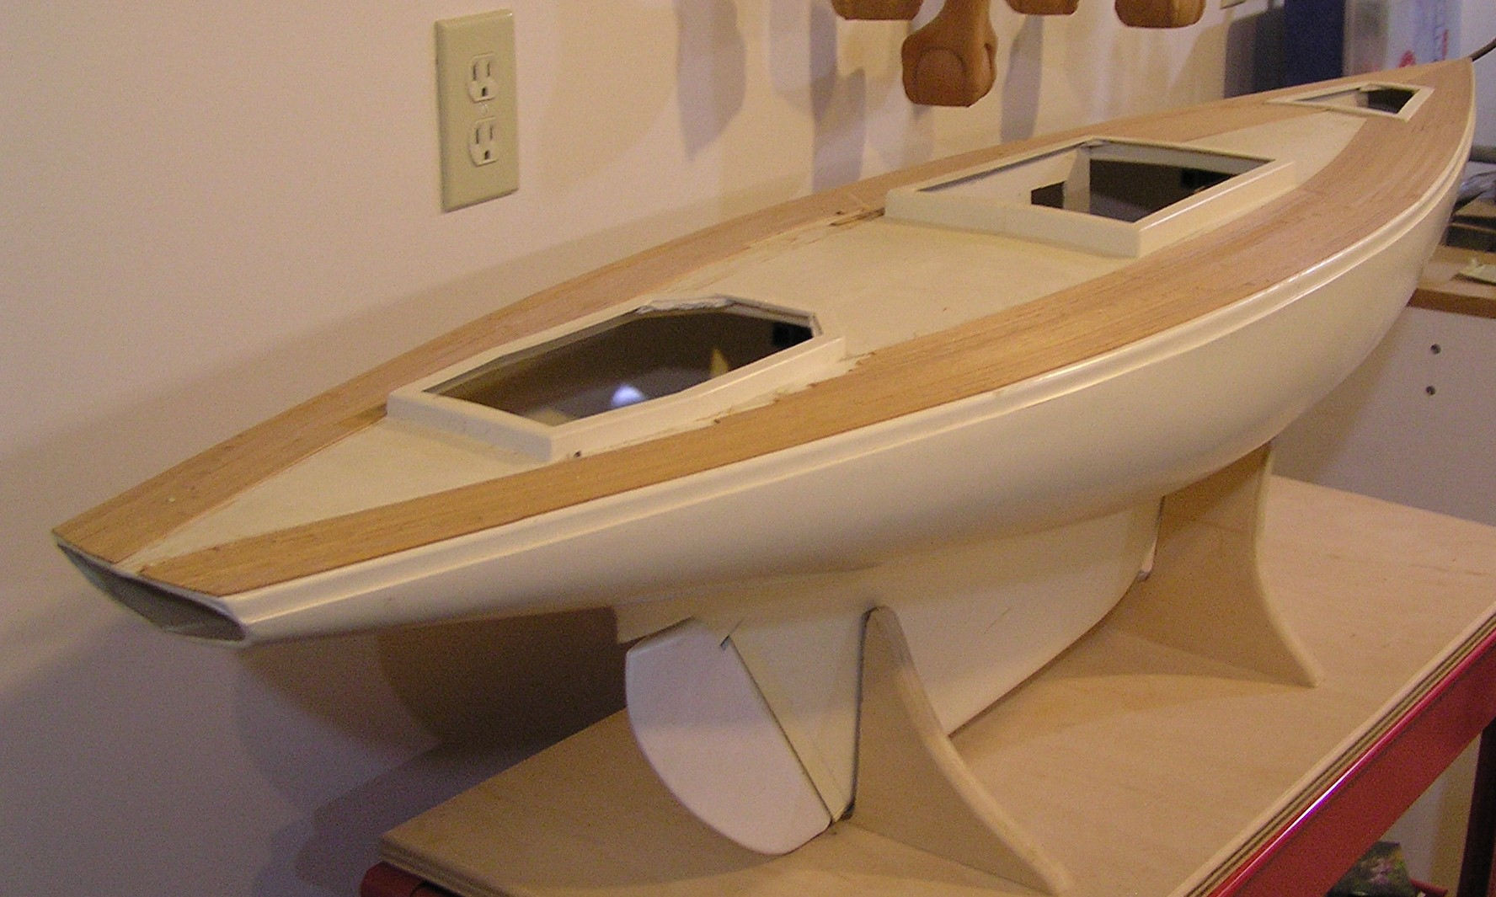
The Robbe Atlantis (As received)
Decking prior to removal
Shop cart an aide with size of this model
Open Transom for feed of R/C Elements

Slide 7
The Robbe Atlantis
Plans for completion:
  Redo decking; mahogany accents and boxwood infill
    Using DAP Rapid Fuse General Purpose
  Make all deck furniture as plans indicate but trim out with boxwood
    Masts: Found in Germany, enroute “circuitously”
    Fitting Set: Found suitable parts in England and California
    Bulwarks: Fabricated out of maple and adding trim
Transportation must be considered when rigging
Full complement of missing parts still unknown
Paint hull to clients specification
Sails need to be detailed
Fabricate a presentation stand

Slide 8
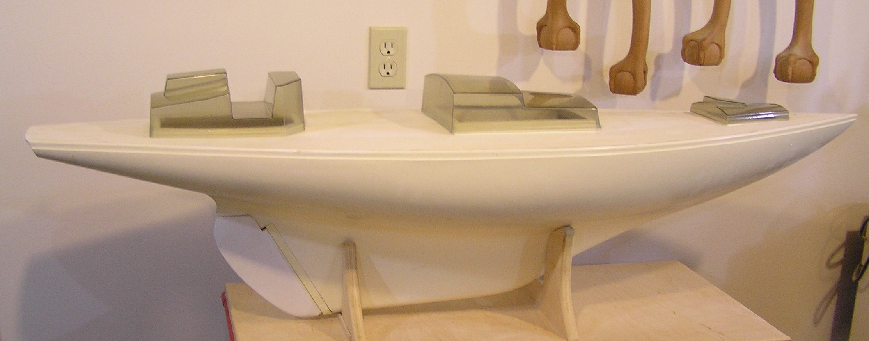
The Robbe Atlantis
Acrylic forms must be built out to achieve deck furniture

