Slide 1
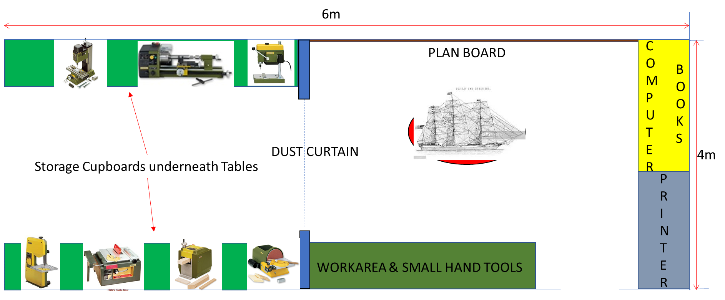

Slide 2

LED LIGHT POSITION

Slide 3


ELECTRICAL PLUG POSITION

Slide 4
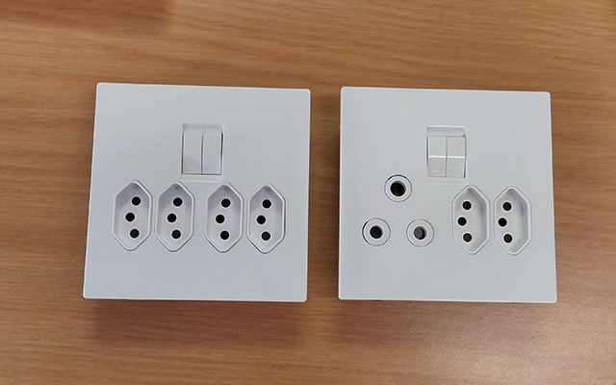
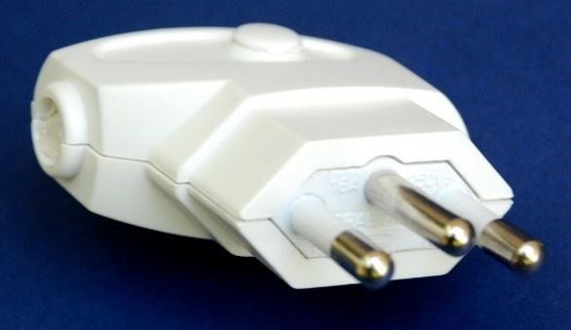
New plug boxes in South Africa

